Slide 1
Birth Data Analysis Project
Ale, Amber, Nathan, Phuong

Slide 2
Our hypotheses relating to birth rates and the age of mothers in Australia
H_{a}1: Australia’s birth rate is decreasing.
H_{a}2: Economic factors are influencing birth rate
Has Australia’s birth rate changed in the period of 2012-2019?
Could mother’s age play a role in the declining birth rate?
H_{a}3: The median age of mothers will increase over time in all areas across Australia.
H_{a}4: Mothers in regional areas are likely to have babies at a younger age than mothers in capital cities due to a range of factors.
Is birth rate similar across Australia’s regional and metropolitan areas?
H_{a}5: There is a small difference between the median age of mothers in Brisbane and the rest of Queensland because the difference for other factors is also small.
Why is Queensland
Almost an exception?

Slide 3

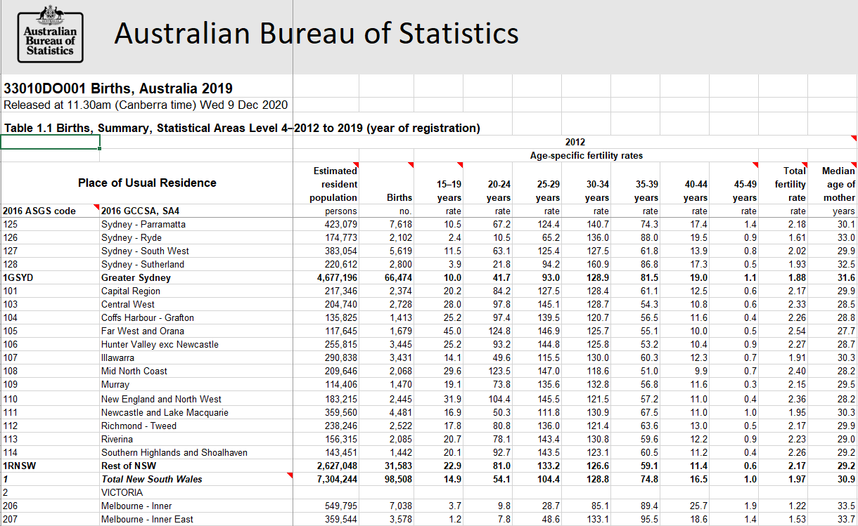
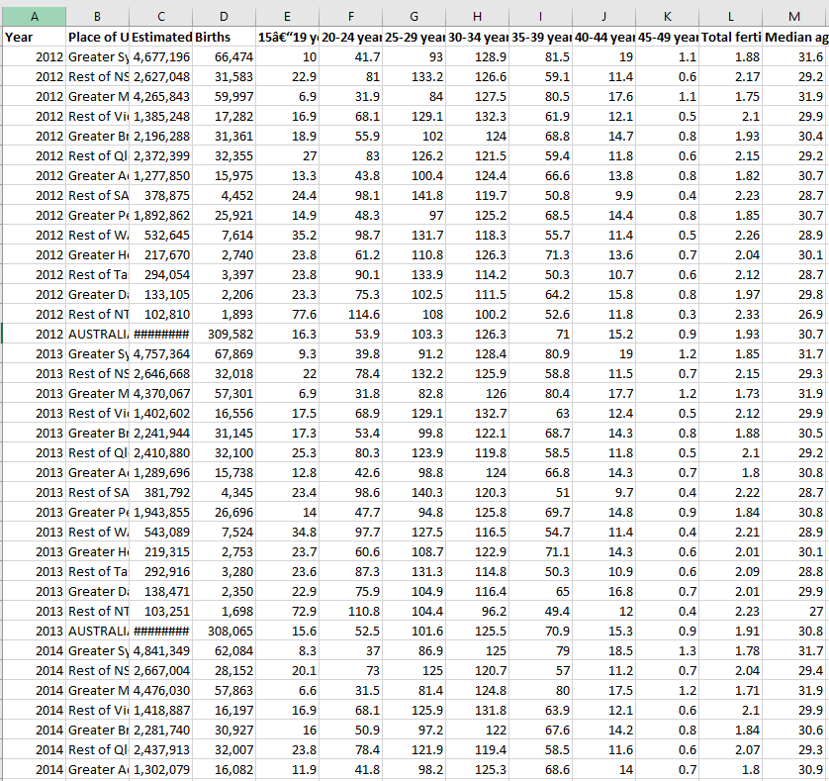

Main Data Source
Census Data 2016
Religion (Christianity), rental stress, mortgage stress, education level.
https://www.abs.gov.au/statistics/people/population/births-australia/latest-release
REMOVED

Slide 4
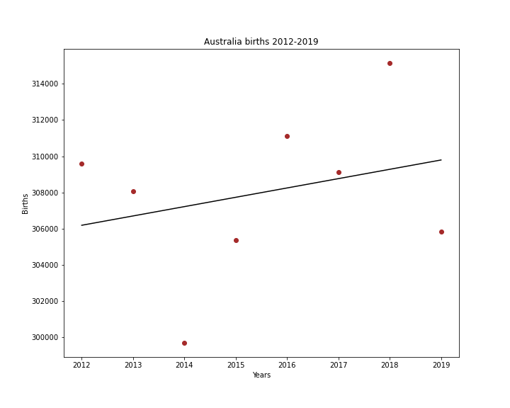
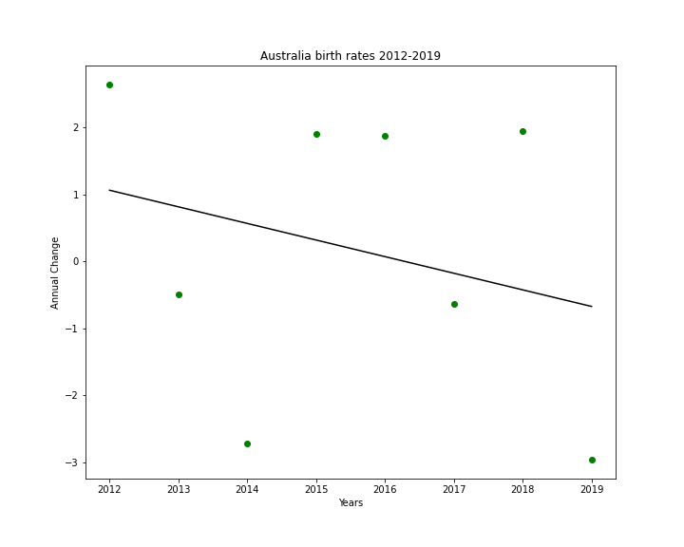
Australia Births Trend 2012-2019

Slide 5
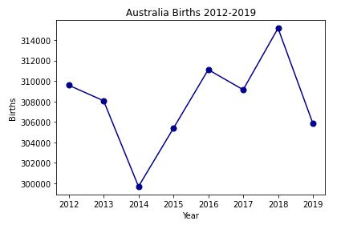
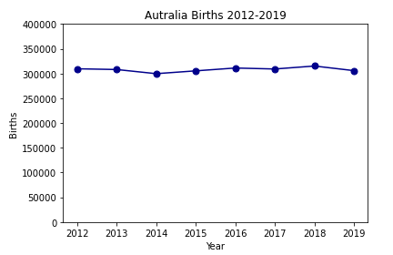
Same data - different perspective

Slide 6
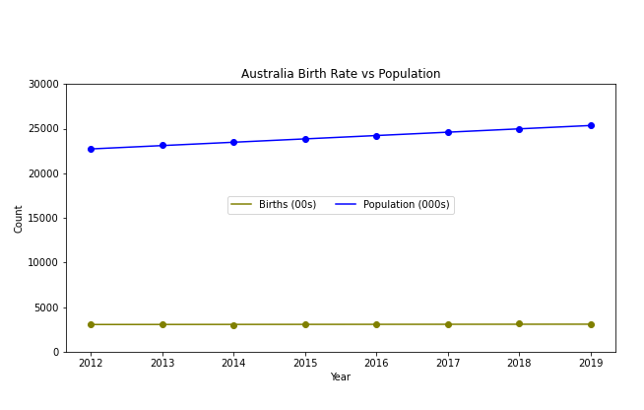
Australia Birth Rate vs Population

Slide 7
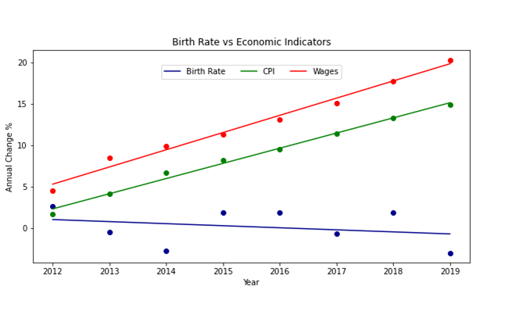
Birth Rate vs Economic Indicators

Slide 8
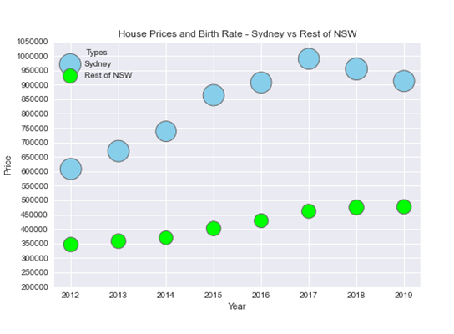
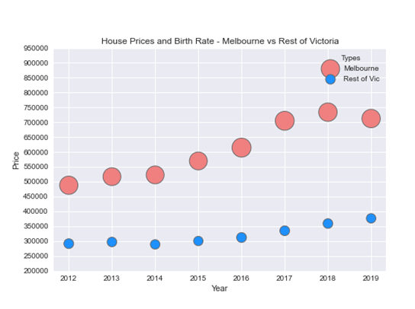
House Price vs Birth NSW & VIC

Slide 9
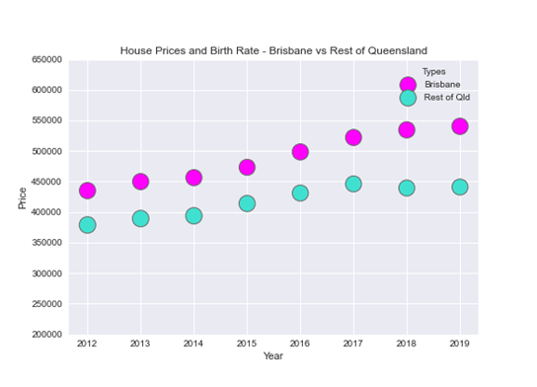
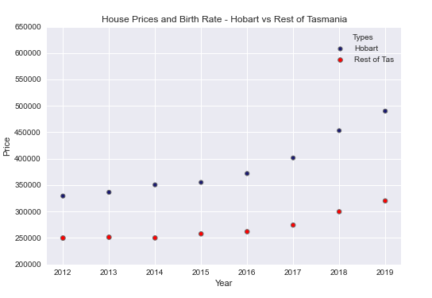
House Price vs Birth QSL & TAS

Slide 10
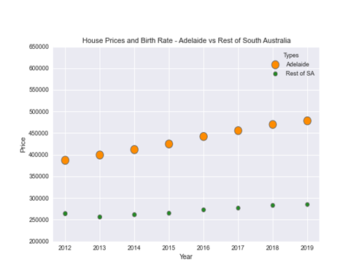
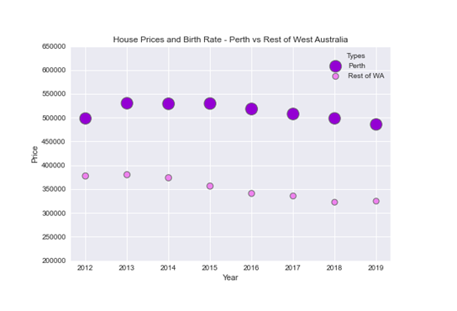
House Price vs Birth SA & WA

Slide 11
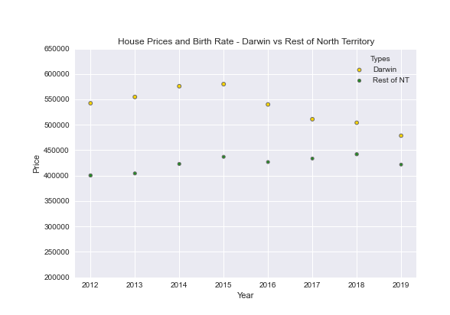
North Territory

Slide 12
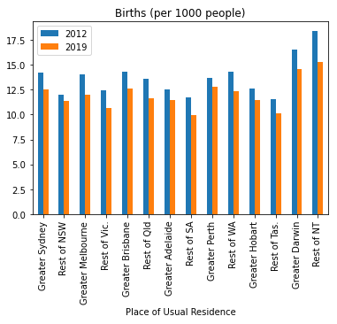
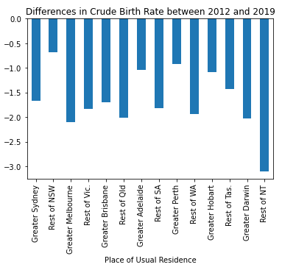
There is a clear decline in birth rates across Australian states and territories

Slide 13
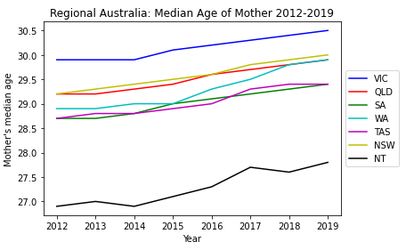
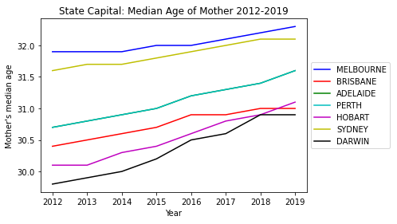
H_{a}3: The median age of mothers will increase over time in all areas across Australia.
Conclusion
Hypothesis is supported but it would be valuable to see this within a larger time frame.

Slide 14
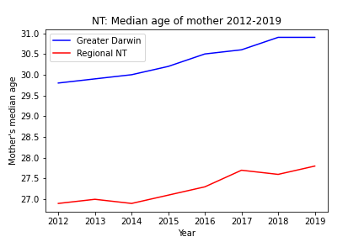
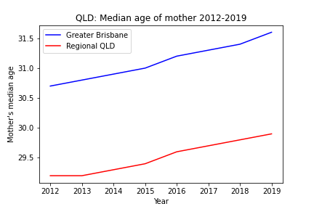
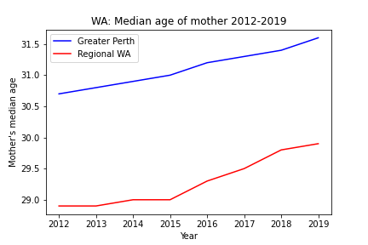
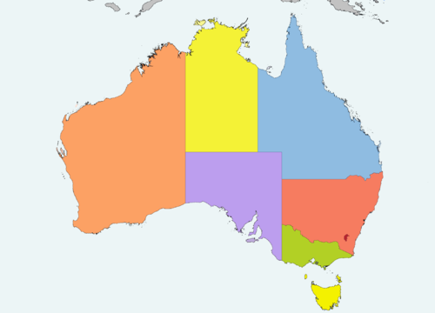
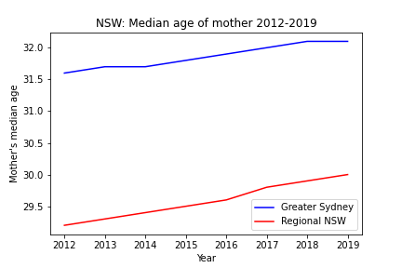
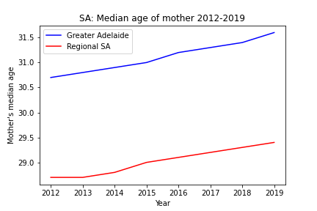
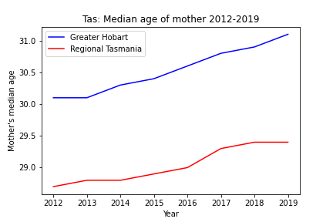
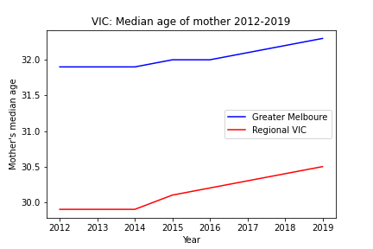
Around Australia mothers are younger in regional areas than in capital cities
3.06 years
1.24 years
1.83 years
2.28 years
2.09 years
1.50 years
1.89 years
Capital cities
Regional areas

Slide 15
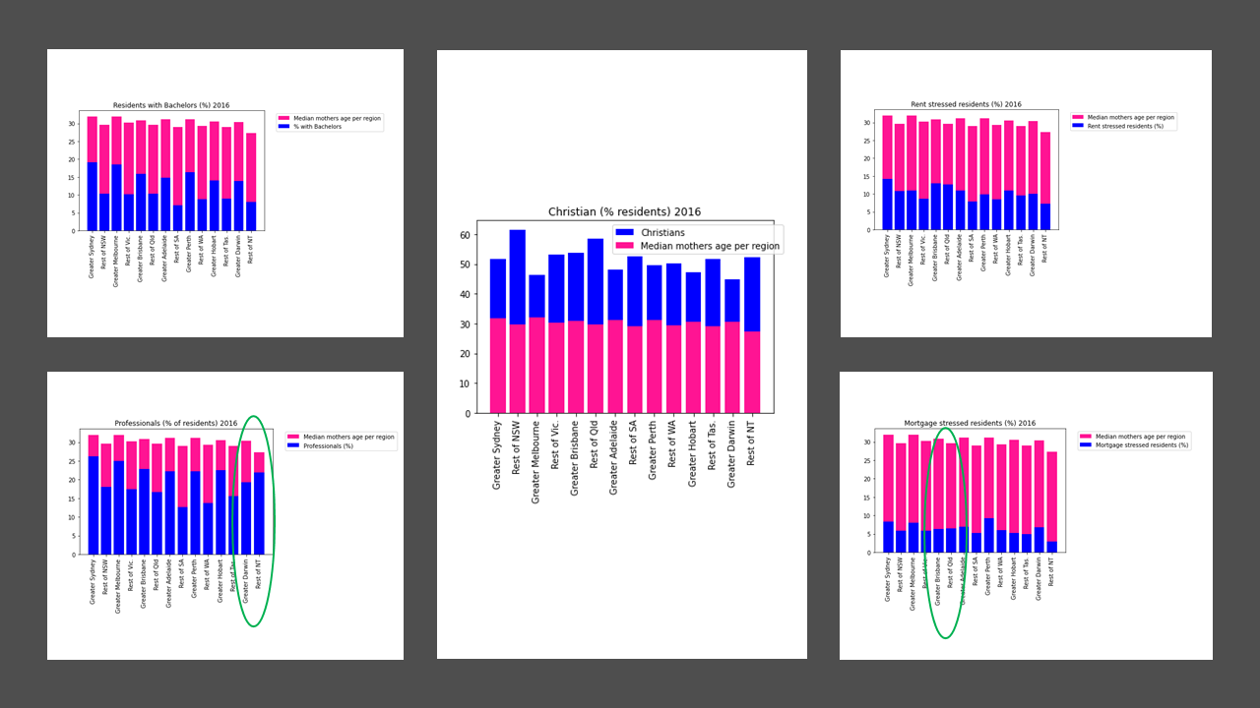
Why mothers around Australia are younger in regional areas than in capital cities
University students focus on finishing studies and so delay having babies
Younger people are more likely to be rent stressed and so delay having babies
Christians uphold traditional values and encourage each other to have babies at an earlier age
Professionals focus on establishing careers and so delay having babies
Younger people are more likely to become mortgage stressed and so delay having babies

Slide 16
Queensland
We have noticed the age gap of mothers having babies between city areas and regional areas across most states is about 2 years (or more).
However, with Queensland the age gap is only by about 1 year. Below are a few factors that could contribute to the difference of age gap between Queensland and every other state.
Monthly mortgage payment
Monthly rental payment
Mortgage stress
Rental stress

Slide 17
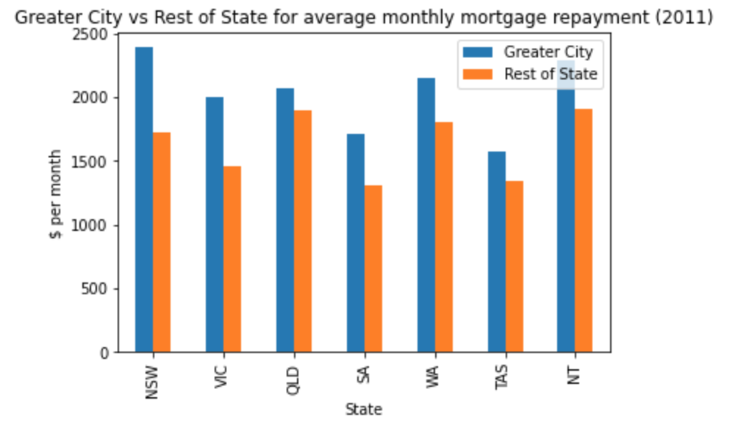
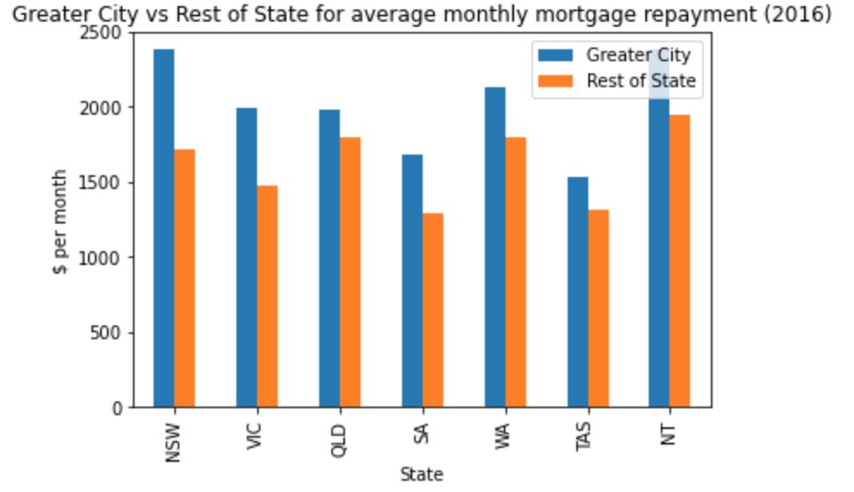
Queensland
1.24 years
2.28 years

